Slide 1
UNIT 11: PRINCIPLES OF SOUND AND AUDIO FOR GAMERS

Slide 2
UNIT DESCRIPTION
Activities in this unit of study are designed to explore the various applications of sound and music, including the selection of appropriate choices, and the optimization of asset formats.

Slide 3


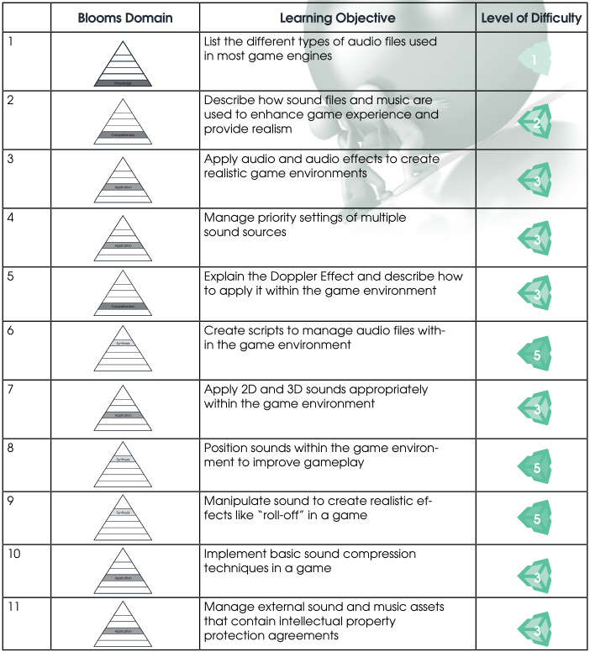
LEARNING OBJECTIVES

Slide 4
COURSE OUTLINE

Slide 5
1. Enhancing Game Experience with Sound and Audio
a. Sounds for game realism
i. Motors, Lasers, Other sound
b. Adding dialogue to the game
i. Game
ii. Character
iii. Player
c. Selecting appropriate music for game experience
d. Finding Sound and Music Sources
e. Proper use of copyrighted music and sound files
Notes:
http://www.ign.com/articles/2017/06/28/gran-turismo-sport-creator-kazunori-yamauchi-talks-sound-steering-wheels-and-shifting-gears-ign-first
https://opengameart.org/art-search-advanced?keys=&field_art_type_tid%5B%5D=13&sort_by=count&sort_order=DESC

Slide 6
2. Audio sources
a. Choosing correct sound file types
i. Wav files
ii. MP3 files
iii. MIDI Files
iv. API Sources: OGG Vorbis, FMOD, SDL
Notes:
https://www.gamedev.net/articles/programming/general-and-gameplay-programming/sound-formats-and-their-uses-in-games-r1902
WAV - Well Documented and easy to use. File size can get pretty large unless you choose to use codecs for them. Good choice to use for sound effects or other small audio pieces.
MP3 - Bottom Line- Well documented, many examples online. Good format to use for a lot of speech or music
MIDI - Bottom Line- MIDIs can be fairly small in size and if given the right IDF can sound great. The format has been around for a long time and because of that there many examples and samples available all over the net.
OGG - Bottom Line- Best compression found in this experiment for song quality audio. Some neat utilities can be found on the site to help you convert your songs to the format without having to write code to do it yourself (always a plus).

Slide 7
3. 2D and 3D Sound
a. Overview of Mono and Stereo format and 2D/3D Sound
b. 3D Sound Settings and Applications
c. 2D Sound Settings and Applications

Slide 8
4. Sound FX: Compression, Doppler, priority settings, playback
a. What is Audio Compression and When to Use it
b. Introduction to the Doppler Effect
c. Applying the Doppler Effect to Game Assets
d. Setting Sound Priorities
e. Volume Rolloff and Rolloff Settings
Notes:
https://docs.unity3d.com/Manual/class-AudioSource.html
https://youtu.be/fWX38qjECyE?t=49s
Doppler effect

Slide 9
Additional Skill Development
The tutorial in this unit is intended to help learners fully understand how music and sound effects add to engagement and excitement in the game:
Audio Listeners & Sources: http://unity3d.com/learn/tutorials/modules/beginner/audio/lessons/audio-sources-and-listeners

Slide 10
Sound and Audio Sources for Game Development
Sound design is an important part of creating a fun and engaging game. Choosing the correct sound format can make or break an interactive application or video game. Sometimes music and sounds do not properly support the theme or the outcome of the game. If integrated poorly, they can distract the player or reduce the sense of engagement of being in the game. As game developers storyboard and plan the game, sound and audio files must be selected or designed for use in the game. In order to be effective in sound and audio design, you must be knowledgeable of sound and audio source formats, resources, sound properties, and parameters.

Slide 11
Weekly assignment
Create the Roll a Ball Game, http://unity3d.com/learn/tutorials/projects/roll-a-ball in Unity. Add sounds to objects in the game that evoke specific moods, actions, or that increase the level of excitement. Integrate as many sounds and effects, as possible, to add enhance the quality of the game environment. Be sure to add sound effects to objects (e.g. rolling ball) that add realism to the game.

